Slide 1




Training Session for Lawyer Volunteers
www.prolawyers.org.nz

Slide 2
Overview of today’s training
Introduction
Terms of Use and Policies
Answering Questions
Food
Write Limited

Slide 3

Meet Suzie
Meet Suzie. Suzie drives trucks.
Suzie is worried that her boss is getting her to drive trucks too much, without enough breaks.

Slide 4
Meet Suzie
How can I find out my rights?
The Community Law Centre would be perfect for this! But the whole problem is that I am on the road too much. I can’t get to Community Law.

Slide 5
Meet Suzie
Wouldn’t it be great if there was a website that gave fast, credible answers to help with unmet legal needs like Suzie’s?

Slide 6

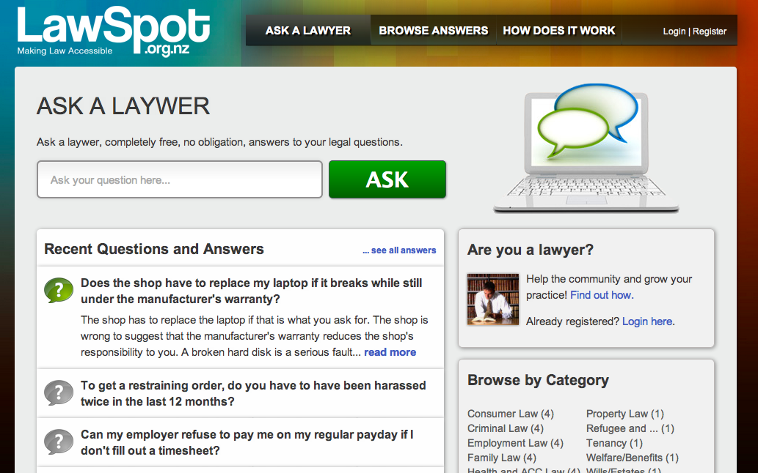

Slide 7

Benefits to the Community
User-generated
Free up some CLC time
Trusted
Accessible
No double ups

Slide 8

How It Works

Slide 9
Terms of Use

Slide 10
What We Don’t Cover
LawSpot does not answer property and business questions:
Questions about conveyancing or property leasing (except residential tenancies)
Questions from landlords
Questions from business ventures and employers
Notes:
Hannah

Slide 11
What We Don’t Cover
LawSpot will provide only basic info about:
Administration of estates
Preparation and execution of wills
Property relationship agreements
Powers of attorney
Enduring powers of attorney
Notes:
Hannah

Slide 12
Legal Categories
Charitable Organisations
Consumer Law
Criminal Law
Defamation
Driving and Traffic Law
Education
Employment Law
Family Law
Health, Disability and ACC
Human Rights and Discrimination
Insurance Law
Legal Aid
Litigation
Maori Legal Issues
Neighbours
Privacy
Property Law
Refugee and Immigration Law
Tenancy
Welfare/Benefits
Wills/Estates
Youth Law
Notes:
Hannah

Slide 13
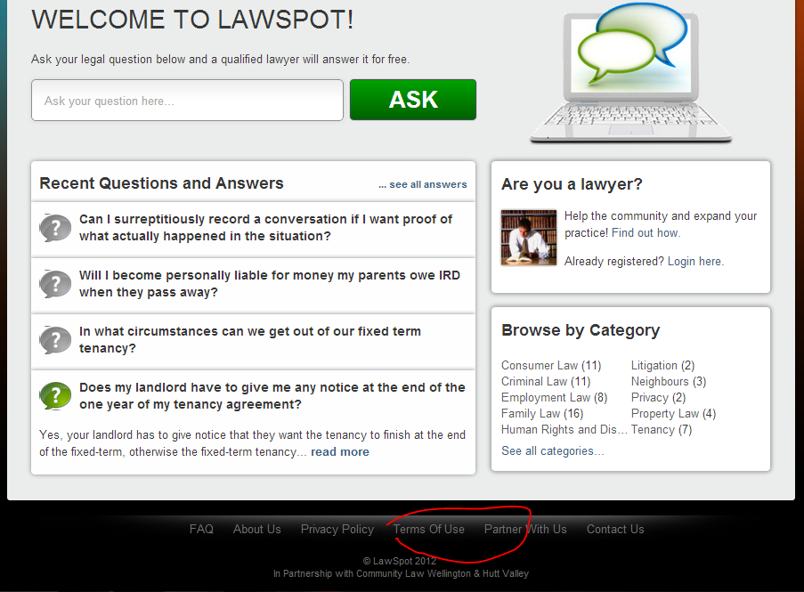
Preliminary Info for Users
Notes:
Hannah

Slide 14
Reasons for Rejection
The question may be rejected or modified.
Reasons for rejection:
Duplicate question
Not for LawSpot
Offensive
Privacy issue

Slide 15
Managing Client Relationship
Confidentiality
Only LawSpot technical team can see user’s email address
Only question vetters will see question as originally submitted
Any personal info contained in the original question is confidential
Only able to be used for limited purposes set out in Privacy Policy

Slide 16
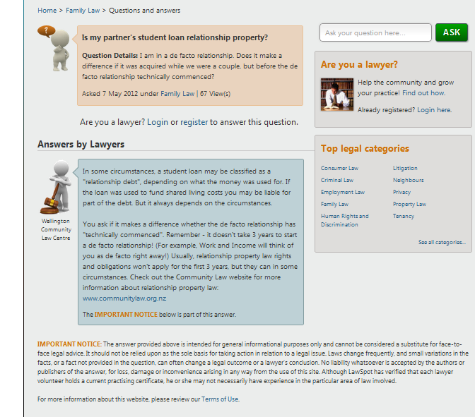
The “Important Notice”

Slide 17
Conflicts of Interest
LawSpot anonymisation process
Ultimately up to you to determine whether a conflict exists
As a volunteer you are responsible for managing any perceived conflict with your offline clients. Use your discretion and contact elizabeth@lawspot.org.nz.

Slide 18
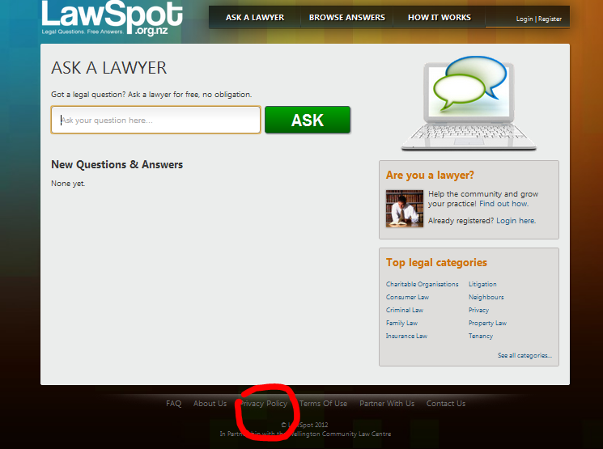


Slide 19
Policy for Lawyer Volunteers

Slide 20
Volunteers’ Personal Info
None of your personal info will be published on the public site, but your email address is visible to other volunteers when they are logged in
Your info will only be used:
For statistical/research purposes
As required by law or for protection of others
For other uses that you authorise, which include contacting you about LawSpot business
(and if you receive confidential or personal info you need to follow the professional rules and the Privacy Act , of course)
Notes:
Hannah

Slide 21
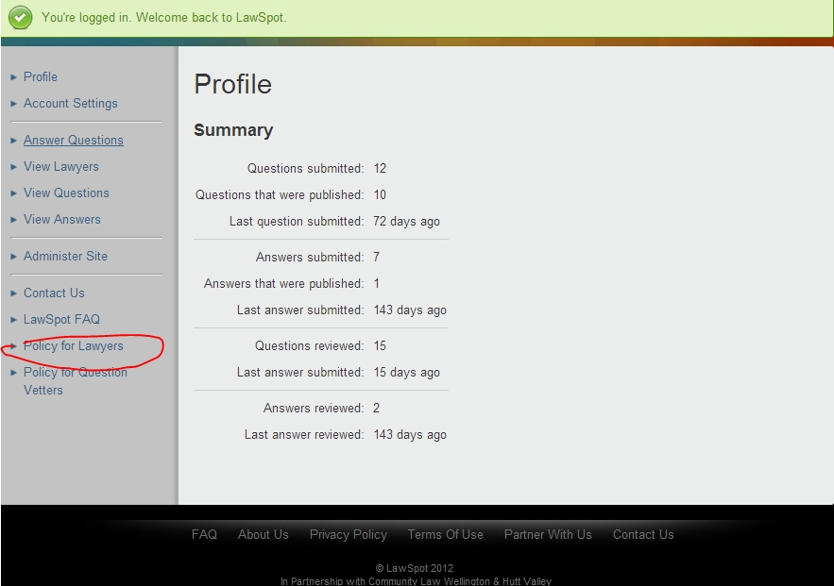

Slide 22
Policy - General
Pro bono basis
LawSpot expects high standards from its volunteers
You may quit at any time
We may cancel your registration at any time
Notes:
Hannah

Slide 23
Volunteers have the right:
To have a clearly defined role.
To say “no” without guilt when asked to take on additional commitments and activities outside your role.
To be respected and trusted.
To question your work environment and have your opinions heard.
To be encouraged and supported.
To have someone or some process to help you solve problems or difficulties that arise in your role.
Notes:
Hannah

Slide 24
Volunteer Responsibilities
To comply with LawSpot’s Terms of Use, Privacy Policy, Policy for Lawyer Volunteers
To take your work seriously and perform to the best of your ability, regardless of unpaid status.
To commit only to things you can achieve.
To act ethically, professionally, and with integrity.
To respect our aims and objectives.
To encourage and support.
To be proactive in resolving problems relating to your role.
Notes:
Hannah

Slide 25
Expectations
There is a backlog.
Two-week rotating roster (your turn every 2nd week)
Two answers per week you’re rostered on (1 answer per week on average)
Prompt turnaround on “rejected” answers
Patience and tolerance
“Mayor of LawSpot” each week and monthly prize
Monday “unanswered emails” update
Monday “LawSpot” update
Contact: Lizzie (elizabeth@lawspot.org.nz)
Attend refresher trainings
Feedback from peer reviewers and from Hannah.
Notes:
Hannah

Slide 26
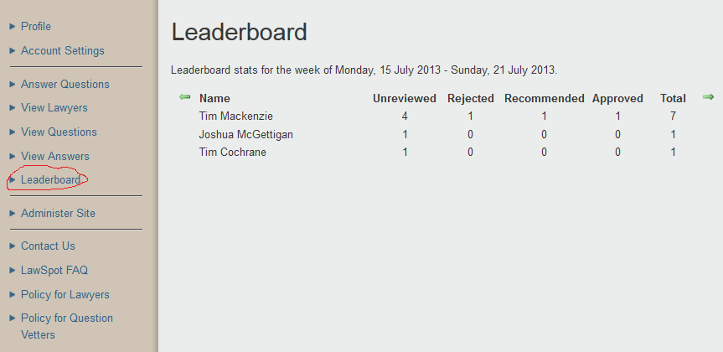
Leaderboard

Slide 27
Answering Questions
(bye vetters!)

Slide 28
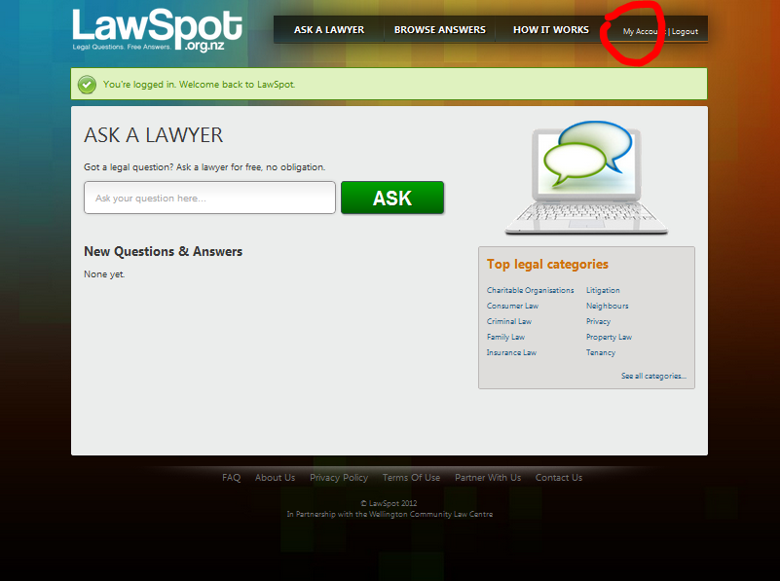
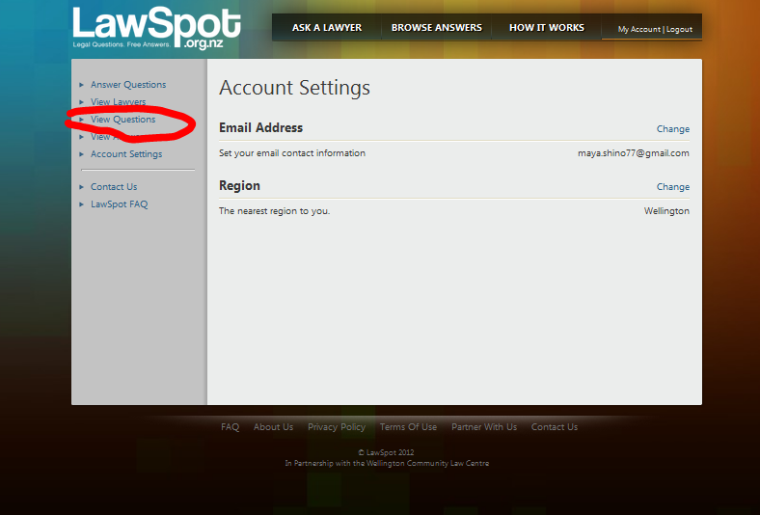
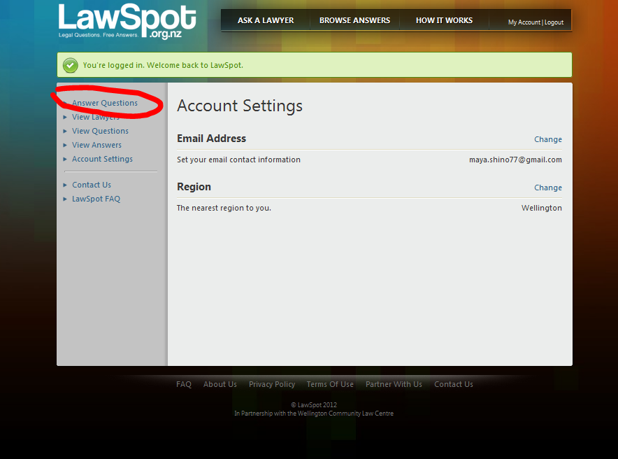
Overview

Slide 29
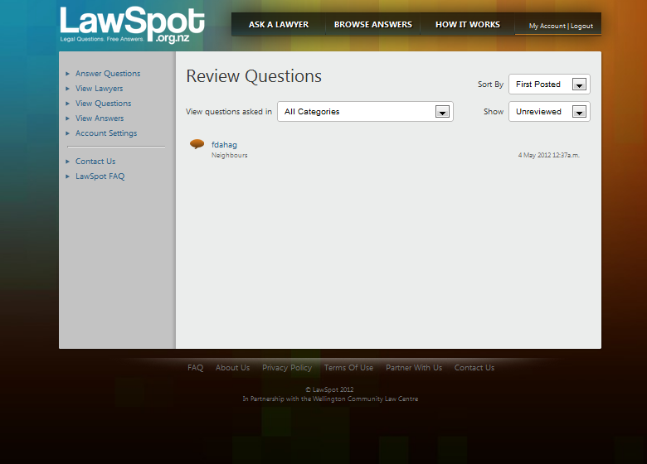
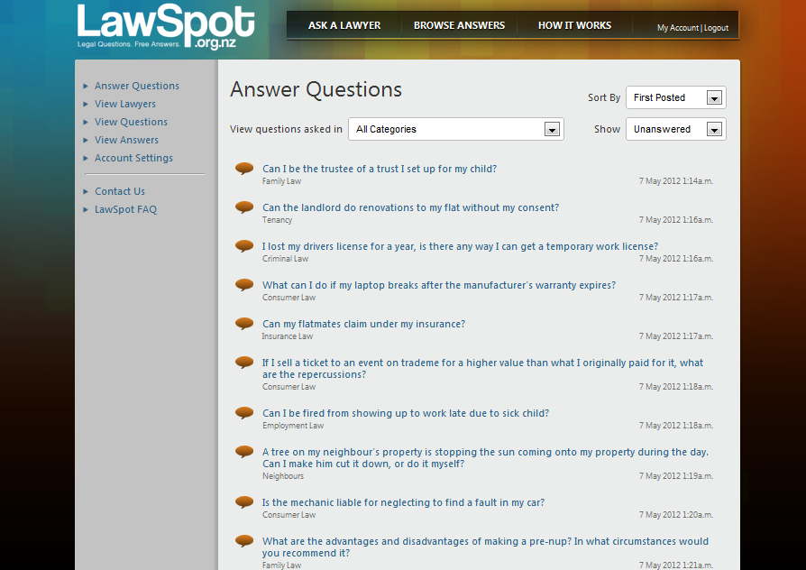
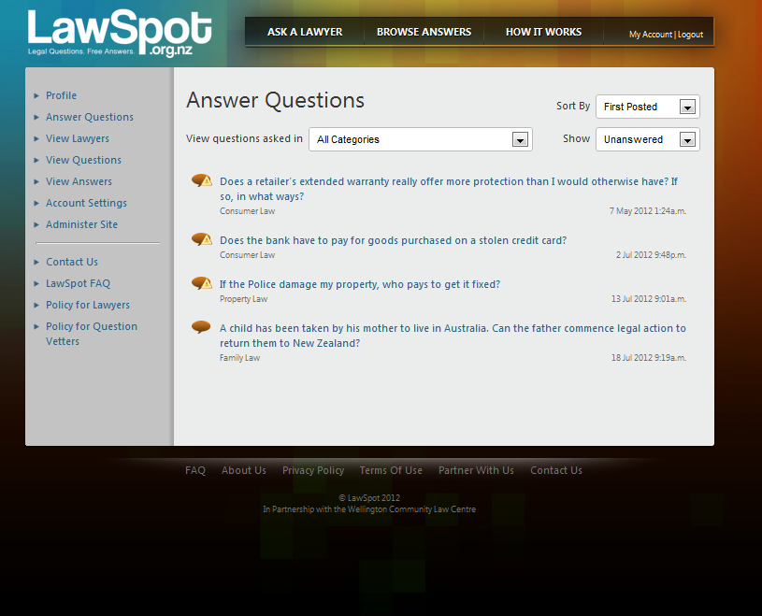
Overview
Notes:
At this point – consider:
What if you see a question that was wrongly approved by a vetter?
What if you suspect (from timing/content of the question) who was behind the question? Ask: might it raise a conflict?
What if a lawyer started drafting the answer ages ago?

Slide 30
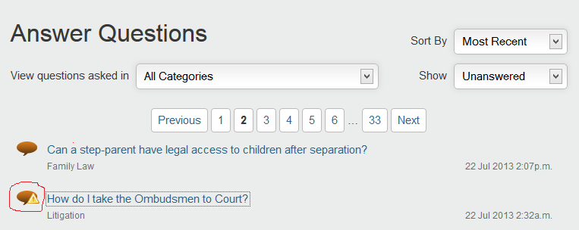
Choosing a question
Speech bubble = free
Hazard sign = taken
Hazard sign removed if the answer has not been updated for 3 days

Slide 31
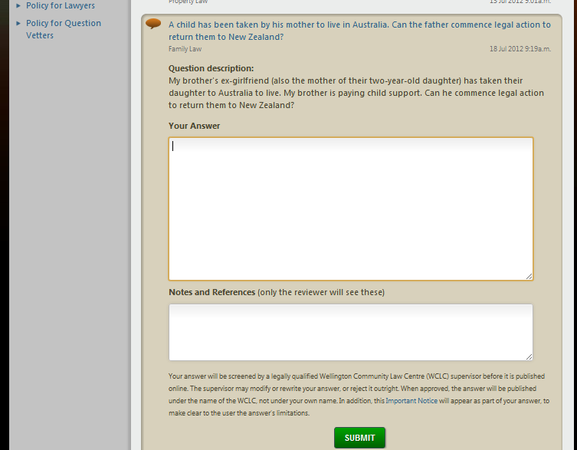
Overview

Slide 32
What We Don’t Cover
LawSpot does not answer business or property questions:
Questions about conveyancing or property leasing (except residential tenancies)
Questions from landlords (unless they are community groups)
Questions from business ventures and commercial employers.
Notes:
Hannah

Slide 33
What We Don’t Cover
LawSpot will provide only basic info about:
Administration of estates
Preparation and execution of wills
Property relationship agreements
Powers of attorney
Enduring powers of attorney
Notes:
Hannah

Slide 34
Vetting process
If you see any problems with a question, email Laura (vetting@lawspot.org.nz)
Spelling errors
Identifying info
Categorisation errors
Inconsistent header and final questions
Offensive stuff
Poor grammar
Nonsense

Slide 35
What we look for in an answer
Brief
Answer the question asked in the headline
Write clearly, using everyday language (not legalese)
Try not to qualify your answer (much)
Links! Especially to Community Law Manual, but also to government or other reputable info
http://www....

Slide 36
What we look for in an answer
No need to paraphrase info that you could simply link to – unless you are synthesising several sources
Pragmatic responses – talking to the person concerned etc – suggesting next steps, referrals, non-legal options, etc
Explanatory notes with detail and links

Slide 37
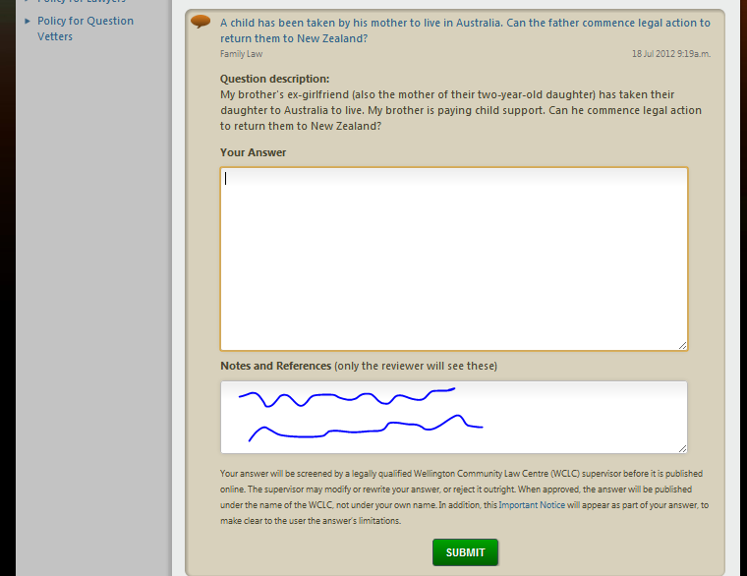
Overview
Notes:
Show lawyers where they will be submitting their answer

Slide 38
Sample commentary
Hi Hannah
To answer this question I relied on:
Chapter 21 of the CLC manual: http://www.communitylaw.org.nz/resources/legal-reference-manual/chapter-21-consumer/
CCCFA
CGA (primarily section 2, to confirm that internet contracts were now specified as a service)
I am a little uncertain myself as to whether a broadband contract would be a credit contract or not. To me, it is clearly caught, but I cannot see any reference to credit contracts, for example, on the Telecom website, even though (assuming they’re credit contracts) a disclosure statement would need to be made before the three working day period would start to run. As before, I’d appreciate any feedback on this point you might have! Thanks

Slide 39
Sample commentary
Hi Hannah
I looked at the "lost/stolen" credit card pages of the main banks - e.g. www.asb.co.nz
I also looked at the neighbourhood support website www.ns.org.nz , the consumer affairs site www.consumeraffairs.govt.nz.
I also used The Laws of New Zealand "Banking" section, chapter 21 "Cards, personal identitification numbers, and passwords" - which stated the law based on the Code of Banking Practice, available on www.nzba.org.nz.
thanks,

Slide 40
Sample commentary
Completed using the Department of Building and Housing's guides at www.dbh.govt.nz%28english%29.pdf and www.dbh.govt.nz%28english%29.pdf, and by reference to ss 45 and 48 of the Residential Tenancies Act 1986.

Slide 41
Sample Questions
I bulk bought apples to sell in my shop and on opening the containers I have noticed that a lot of them are rotten - do I have to pay for all of them?
Notes:
Test question – to demonstrate that this should not have been approved by question vetters as it is from a business owner

Slide 42
Sample Questions
What are the requirements for a valid will?
Notes:
Another test question – we would only provide very general/limited information to questions relating to wills

Slide 43
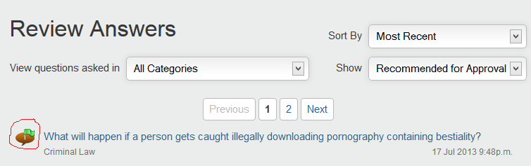
Review process
Answer reviewed by a peer reviewer or volunteer
Reviewer can “reject” or “recommend for approval”

Slide 44
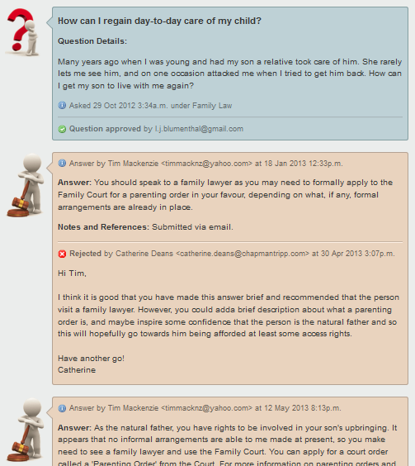
History tracker

Slide 45
“Rejection”
More like “review”
Please re-work your answer
Please respond in the commentary box (notes and references)

Slide 46
Sample Questions
I’ve been charged with possession of cannabis. Can I get diversion?

Slide 47
Sample Questions
Discretionary, and depends on your situation, which we don’t know enough about
Offender-based criteria (personal history etc)
Offence-based criteria (circumstances alleged)
Assuming full responsibility
Talk to the Duty Lawyer or the Police
Link to Police website
Notes:
Hannah

Slide 48
Sample Answers
If I sell a ticket to an event on TradeMe for a higher value than what I originally paid for it, what are the repercussions? Could the ticket be cancelled?
There is a possibility that the ticket could be cancelled.
The two major ticketing agents in New Zealand - Ticketek and Ticketmaster - both attach terms and conditions to tickets they sell that generally prohibit the selling of tickets for more than their face value via auction sites or any other unauthorised means. If you breach the terms and conditions attached to the ticket they will have the right to cancel your ticket.
The ticketing agents impose these terms and conditions in effort to stop ticket scalping, which is only illegal in certain circumstances. The Major Events Management Act 2007 makes it illegal to sell a ticket to a “major event” for greater than face value. Any breach of this and you may be liable for a $5,000 fine. However, very few events are declared “major events” with best example being the Rugby World Cup 2011. A concert put on by your favourite band is unlikely to be classified as a “major event” and these restrictions will not apply.
There is some good news. The major ticketing agents recognise that there may be a legitimate reason why you can no longer attend an event and want to sell your tickets online. They will not object to you selling tickets for face value or less. The best way to ensure your tickets do not sell for more than their face value would be to take advantage of TradeMe’s Buy Now function and set the price at face value or below.
Notes:
Hannah

Slide 49
Sample Answers
What do I have to tell police if they search our flat and a flatmate gets caught with drugs? If the police search our house because our flatmate was caught with drugs, and they ask me if I know where anything illegal might be or about any of his activities, what am I legally required to tell them? Everything; just information about drugs; nothing?
You do not have to tell the police anything. As a general rule the police have no power to require a person to provide them with information. You can volunteer information regarding your flatmate if you wish in order to provide assistance to the police. You can read more about your rights with the police here: www.communitylaw.org.nz/resources/legal-reference-manual/chapter-6-police-powers/police-powers-of-questioning/
Notes:
Hannah

Slide 50
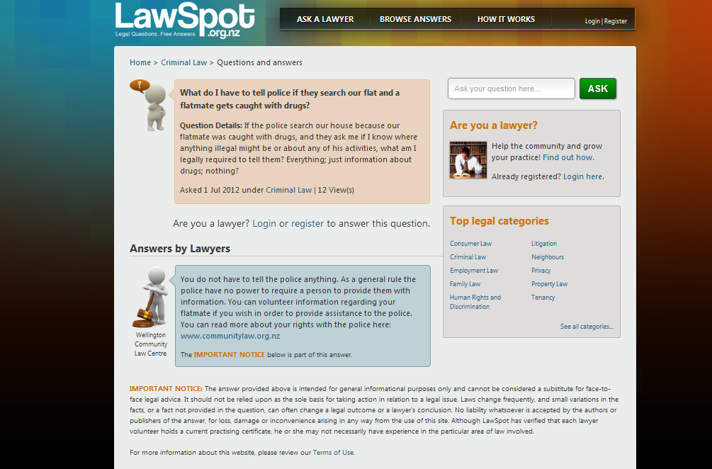
Overview
Notes:
Show lawyers where they will be submitting their answer

Slide 51
Sample Answers
My stereo was impounded by noise control officers. How do I get it back? The same thing happened to my brother in a different town too. Are the rules the same everywhere?
The enforcement of noise control regulations can vary between different cities and regions. When your brother had his stereo seized it is highly likely that the noise control officers would have given him details on how to reclaim it. However, if not, we recommend that he gives his local council a phone call to find out more information.
In Wellington, a stereo taken by Council's Noise Control Officers is held at the Council offices. The equipment is returned after the owner pays a fine and agrees to keep noise to a reasonable level in future. Read details here about reclaiming your equipment: www.wellington.govt.nz/services/noisecontrol/reclaiming/reclaiming.html
Notes:
Hannah

Slide 52
Sample Answers
I am a New Zealand permanent resident. Are there any reasons for which I could be asked/forced to leave NZ?
Yes. There are reasons you can be deported from New Zealand if you are a permanent resident. Read more here: http://www.immigration.govt.nz/migrant/general/generalinformation/immigrationact/factsheets/Deportation.htm
Most of the reasons are related to not following immigration law, or committing a crime.
Notes:
Hannah

Slide 53
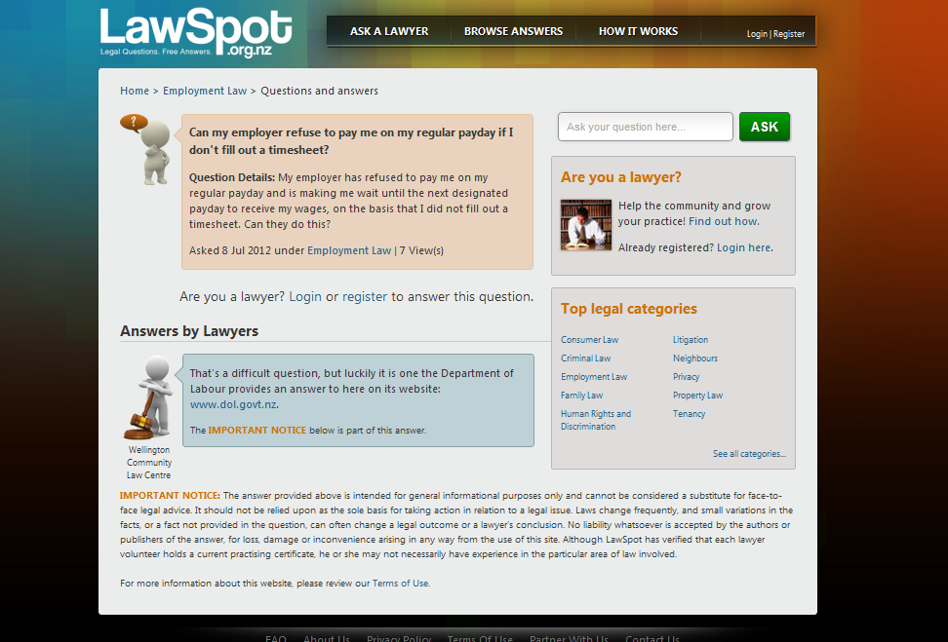
Overview
Notes:
Show lawyers where they will be submitting their answer

Slide 54
Quiz!

